Slide 1
Predicted Churned Customers For Lloyd Bank Group

Slide 2
Features Selection
Age
Login Frequency
Gender
Marital Status
Income Level
Service Usage
Categorical Features will be in ‘Label Encoding’

Slide 3
Train Valid Test Split
75-15-10 as a golden ratio for XGBoost Model
Automatic Threshold Tuning For Calibration

Slide 4
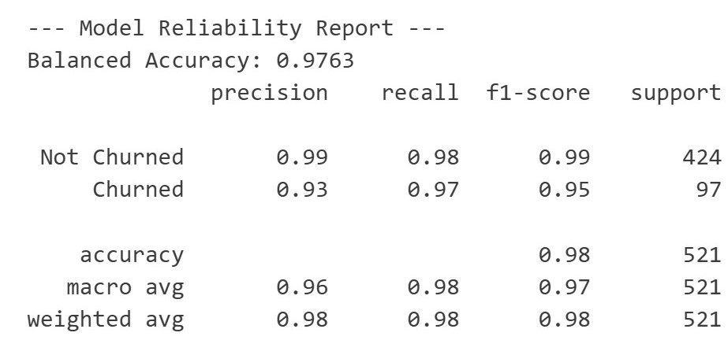
EVALUATION

Slide 5
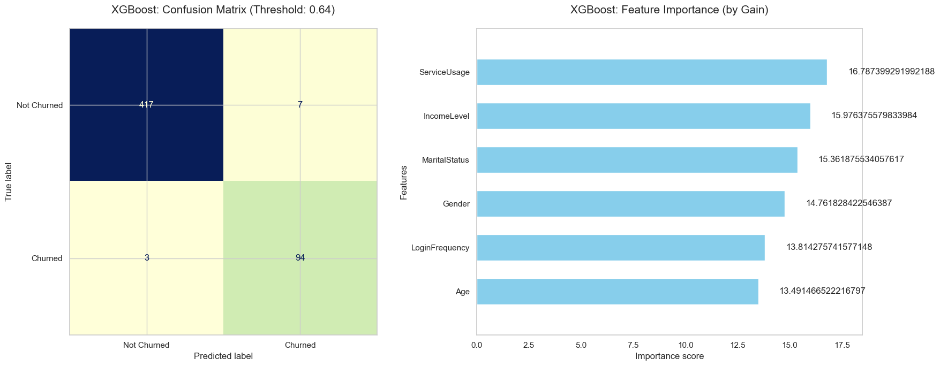
Predictive Performance Visualization

Slide 6
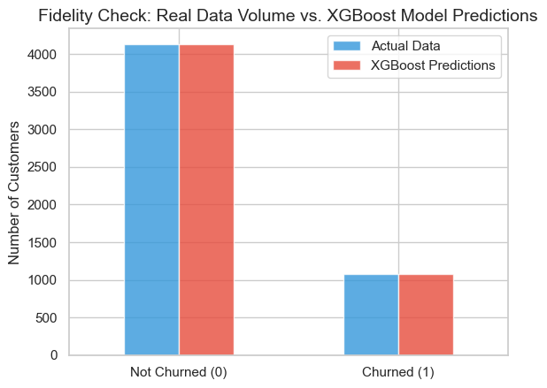
Fidelity Check

